Slide 1
Ngā Wai Ariki o Rotorua
DRAFT Geothermal System Management Plan
Presentation to Rotorua Lakes Council 1 November 2023

Slide 2



What we will cover
What is the Rotorua Geothermal System?
What is a System Management Plan (SMP)?
How was the Draft SMP developed?
What are the key drivers to manage the system?
What key changes are we proposing?
What are the implications?
What is the process from here?
For more detail visit www.boprc.govt.nz or come to our technical presentation

Slide 3
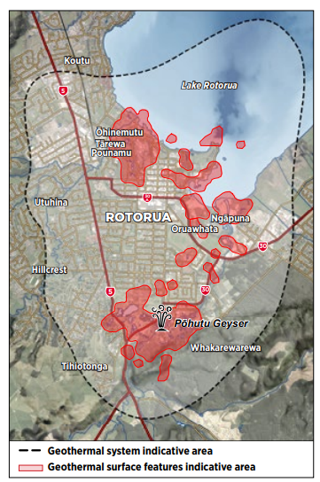
Ngā Wai Ariki o Rotorua
In Taupō Volcanic Zone
One of last remaining geyser fields
Over 1,800 features or ngāwhā
Part of everyday life for haukāinga
130 consented takes
Space and water heating, and bathing
90% reinjection
Managed to protect surface features

Slide 4
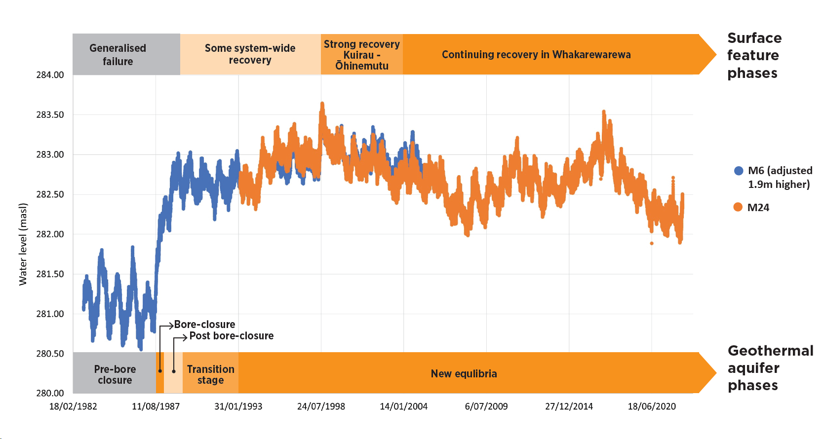
Health of the geothermal system

Slide 5
What is the System Management Plan?
BOPRC’s geothermal functions under the RMA
A requirement of the Regional Policy Statement
Scope limited to BOPRC’s geothermal functions
Only covers the Rotorua Geothermal System
Sets direction for system wide management
Does not direct the District Plan
Is not a regional plan, but signals intent for upcoming regional plan change

Slide 6
Development of the SMP
Multiple hui-a-iwi
Targeted hui with iwi entities
Ahi Kā Roa Rōpū - hau kainga working group
Issues and options hui and workshops – (RLC participation)
Council workshops/Kōmiti Māori
Rotorua Geothermal Liaison Group (RLC participation)
Targeted input from industry

Slide 7
Building our evidence base
Long term monitoring of surface features and geothermal aquifer
Heat flow surveys, thermal infra-red, chemistry
Geothermal reservoir modelling to predict future changes
Ahi Kā Roa Rōpū perspectives: He Kohikohinga
Best practice guidelines on geothermal discharges, geothermal production systems, efficiency, well maintenance (Rotorua Lakes Council input)
For more visit www.boprc.govt.nz (technical reports, guidelines and videos)

Slide 8
Key findings
The system has recovered, is still changing and may recover more
Healthy surface features need a hot and full aquifer
Increasing geothermal water takes and heat only takes could affect system health
We won’t get much warning if we get it wrong
Some features and areas are more sensitive than others
Our ‘sustainable operating space’ is small
Access is weighted towards commercial use
Our Treaty partnership must underpin management

Slide 9
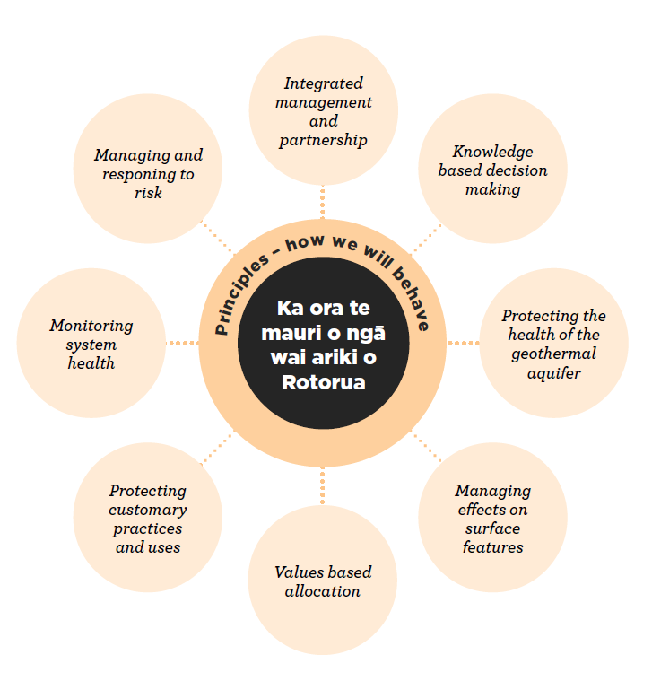
Vision, principles and management approach

Slide 10
Key changes proposed
Approach | Example of new approach
Knowledge based decisions | Providing for Mātauranga Māori
Protecting aquifer health | Keeping use at, or close to current levels (water and heat)
Sensitive management areas | Sensitive management areas, ‘deep system’
Values based allocation | Future prioritisation of use (customary, communal, wellness)
Greater efficiency | More reinjection, down hole heat exchangers, metering
Treaty Partnership | Tangata whenua oversight of implementation of SMP

Slide 11
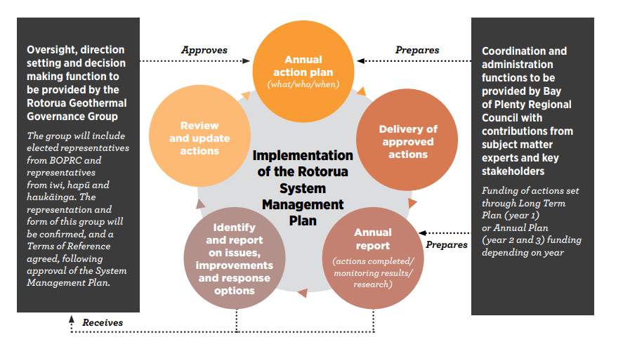
How will the SMP be used?
Considered in consent applications when approved
Will not override the Operative Regional Plan
Formal regional plan change still needed

Slide 12
What does the SMP mean now?
Sustainable customary practice is unaffected
Existing consented takes continue
More scrutiny around efficiency and monitoring on consent renewal
More scrutiny in Sensitive Management Areas on consent renewal (e.g. push to DHX where possible)
Careful assessment of effects of new or increased takes - new large takes very unlikely
Realistic expectations and consistent messaging

Slide 13
Next steps
Technical presentation 20 November
Feedback closes on 8 December
Opportunity for oral feedback in February 2024
Consideration by joint panel
Revised SMP adopted – March 2024
Early consultation on Draft Regional Plan Change
Draft Regional Plan Change - March/April 2024
Proposed Regional Plan Change
Submissions on Proposed Regional Plan Change

Slide 14
Some things to think about
How do we ensure consistent messaging to the community about geothermal use?
How do we strengthen our existing working relationships?
What are your thoughts on prioritisation of use?
Could sensitive management areas will be useful for spatial planning and district planning processes?
See other questions in the Draft SMP

Slide 15
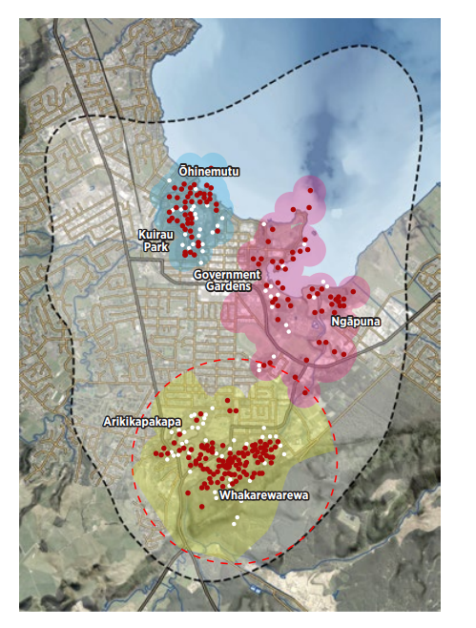
Sensitive Management Areas

Slide 16
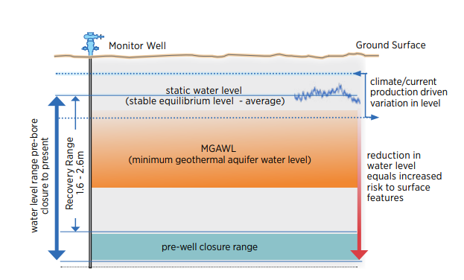
Allocation – safe operating space

Slide 17
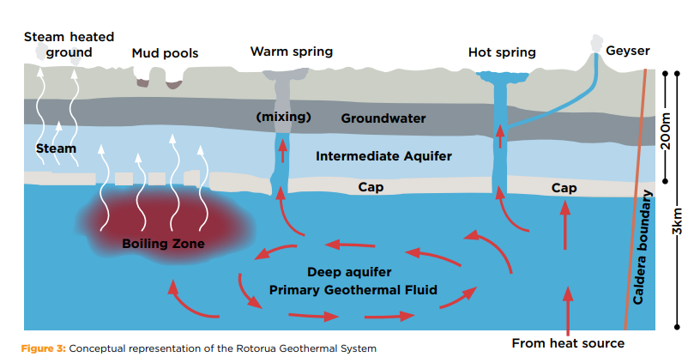
Ngā Wai Ariki o Rotorua
Conceptual representation of the Rotorua Geothermal System

